Slide 1
Channel Partner
Playbook
Notes:
Thank you for your time today. We are excited to review with you how to work best with Paycnex.
Be sure to add the agency logo or name to this slide

Slide 2
Let’s Review
The power of Paychex
An opportunity for partnership
Getting started
Tools and resources, just for you
Notes:
Rep Notes:
So today, let’s:
Explore your business goals and objectives
Discuss the power of Paychex
Review the opportunity we have to partner
Review our tools and resources available to your clients
Is there anything else you would like to cover?

Slide 3
The Power of Paychex
Notes:
I realize you have already gone through the prior presentation regarding the Power of Paychex I did want to point a few key differentiators again.
We have a solution for every client: PEO, ASO, Payroll, and 401K within a fully integrated platform.
We also have a channel partner support team with many tools and resources that we will review today.

Slide 4
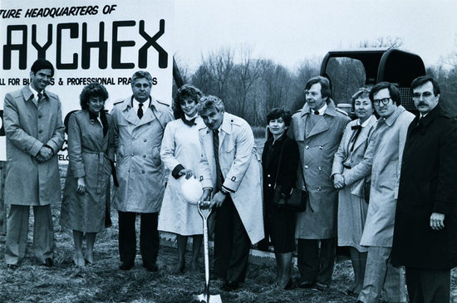
The History of Paychex
Paychex was founded in 1971 by Tom Golisano, who started the company with only $3,000.
Notes:
Paychex has a long and meaningful history. Our founder Tom Golisano started Paychex with only $3000 that he borrowed from his sister’s credit card. Tom knew there was a need for support for smaller payroll clients and he paved the way for Paychex to become the engine that it is today.

Slide 5
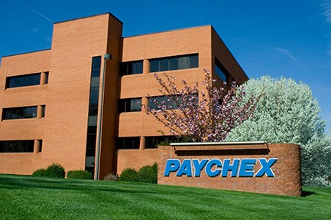
The History of Paychex
In December 2018, Paychex closed on its acquisition of Oasis, making it the second largest PEO in the U.S. We have over 730,000 clients that rely on us as their trusted partner.
Paychex and Oasis rebranded to Paychex HR in 2022.
Notes:
Recognizing that HR was becoming more and more important, Paychex sought out Oasis the largest, privately owned PEO in the Industry. In December 2018 Paychex acquired Oasis making it the 2nd largest PEO in the US. Oasis was rebranded to Paychex HR in 2022 and we currently have over 730,000 PEO clients nationwide.

Slide 6
Why Choose Paychex
Experience, Stability, & Reputation
HR Advice & Guidance
Continuous Enhancements in Tech & Benefits
+
Notes:
What is most important to all of us when selecting a new partner or vendor to work with?
There are several factors to consider such as experience, stability and reputation
Making sure you are doing business with someone that can be trusted should be at the top of the list especially since you are trusting us with your clients.
Paychex continues to provide that piece of mind for channel partners and their clients by being awarded one of the most ethical companies year after year
HR support and guidance is a leading factor for most of our clients, you can see that we provided services to over 1.7 million and it continues to increase daily based on our proactive approach and being the largest HR outsourcer
We continue to make strides with our technology and have been recognized for those technical advances
We become that partner that your clients can rely on.

Slide 7
The Value of Paychex
$0
Best PEO for mid-size businesses – Business News Daily
Best HR outsourcing for small business overall
– Inc.com
One of the world’s most innovative companies
– Forbes
One of the world’s most ethical companies
14-Time Honoree
– Ethisphere® Institute
One of the world’s most admired companies
– Fortune 2022
Largest recordkeeper of 401(k) plans in U.S. by number of plans.
– Plansponsor Magazine 2022
Top HR product of 2021
Paychex Flex® – Human Resource Executive Magazine
Publicly traded on NASDAQ (PAYX)
Long Term Debt
1 in 15
private-sector employees paid
$600 billion
in annual fund transfers
6,500
state and federal regulatory changes tracked annually
11.6 million
Forms W-2 distributed annually
Notes:
Rep Notes:
As you can see Paychex has a record of winning awards. What this means for your clients is two things:
First you they are partnering with a great company; most importantly, an ethical and financially stable company
Secondly - they are partnering with a company that has the experience, expertise and resources to support your success
We provide an array of benefit options that can be customized for your clients needs along with a dedicated service model that supports your clients short and long-term objectives and overall vision.
As you can see Paychex was named the best PEO for mid sized businesses by Business News Daily
Additionally, we are the largest recordkeeper of 401k plans in the country. This is not by accident as our fully integrated solution is a clean transfer of information.
Lastly, we have $0 in long term debt and we pay 1 in 15 employees nationwide.

Slide 8
The Benefits of a PEO
27%
Annual Return on Investment (ROI)
Employee turnover
Health benefits costs
HR-related costs per employee per year
20%
37%
$1,775
Workers’ compensation costs
Concerns about hiring and retaining
Notes:
Your clients Working with a PEO has proven successes. Research from the National Association of PEOs (NAPEO) shows an average ROI of 27%, a savings of nearly $1775 per employee in HR related costs from using a PEO.
Other key benefits include:
A downturn in overall turnover
Cost containment strategies around benefits and HR
An opportunity where we can help mitigate risk for our clients from employee relations complications

Slide 9
A Relationship Opportunity with Paychex
Notes:
Now let’s discuss the opportunity we have that will allow you to increase revenue, lower expenses, while providing additional products and services to your clients.

Slide 10
Paychex HR Channel Strategy
Paychex Channel Partner Program
Partner Channel
Business Consultants
P&C Agents
Financial Advisors
Full Service
Health Agents
PEO Brokers
Notes:
Paychex is taking our channel approach seriously. We've invested dollars and resources into making our program one of the best. We're prepared to tackle any client or situation with you. Our program partners with business consultants, P&C agents, financial advisors, large General Agencies, health agents, and PEO Brokers.

Slide 11
Channel Partner Characteristics
Consultative and value based
Put the needs of their customers first
Forward thinking
Willing to refer, know when to refer, and don’t just refer when there’s no other options
Transparent
Collaborative
Notes:
We have already established that you are a great fit for our program. We have many years of experience with over 600 channel partners and here are some characteristics that have resulted in success.

Slide 12
Channel Partner Characteristics
Communicative
Willing to meet on a consistent cadence for education, lead flow, review, support, etc.
Provides access to clients, organizations, and leadership
Notes:
What we're looking for in a channel partner.

Slide 13
Payout Example
We’ll pay an average 20% residual per referral per month for as long as your client remains a Paychex customer.
Notes:
Optional Slide PEO Brokers and Business Consultants

Slide 14
P&C Agents – Flexible Payout Example
Commission Example Without Attachment
40 employee prospect
$40,000 annualized admin fee
@ 20% commission =
$8,000 annualized commission
Commission Example With Attachment
40 employee prospect
$40,000 annualized admin fee
@25% commission –
$10,000 annualized commission
Notes:
Optional slide for P&C Agents.

Slide 15
H&B Agents - Flexible Payout Example
Commission Example Without Attachment
40 employee prospect
$40,000 annualized admin fee
@ 20% commission =
$8,000 annualized commission
Commission Example With Attachment
40 employee prospect
$40,000 annualized admin fee
@ 30% commission =
$12,000 annualized commission
Notes:
Optional slide for H&B Agents.

Slide 16
Sample Payment Plan*
Commissions Payment Calculation Based on Average Administrative Fees Billed and Collected.
Total Employees | Admin Fee Per WSE Per Year | Annualized Admin Fee | Average Commission % | Annualized Commissions**
40 | $1,000 | $40,000 | 20% | $8,000
Cumulative Commissions Payment Plan Example***
Sales Quarter | New WSE’s | Admin Fee Per WSE Per Year | Annual Admin Fee | Average Commission % | Cumulative Annualized Commissions
Year 1 | 1st qtr 2nd qtr 3rd qtr 4th qtr | 40 80 120 160 | $1,000 $1,000 $1,000 $1,000 | $40,000 $80,000 $120,000 $160,000 | 20% 20% 20% 20% | $8,000 $16,000 $24,000 $32,000
Year 2 | 1st qtr 2nd qtr 3rd qtr 4th qtr | 245 330 415 500 | $1,100 $1,000 $1,000 $1,000 | $245,000 $330,000 $415,000 $500,000 | 20% 20% 20% 20% | $49,000 $66,000 $83,000 $100,000
Avg. 40 wse’s per qtr
Avg. 85 wse’s per qtr
*This is a sample demonstrating how the payment program can work based upon the assumptions noted. This is not a guarantee and employee sizes, annual payroll, service fees, and percentages paid can vary.
**Payments are paid monthly with no cap and no limit
***The residual is paid per the elected continuation as stipulated in the Oasis Channel Program Agreement
Notes:
This is a sample payment plan that takes into account an average client of 40 WSE, a conservative $1000 annual admin fee per WSE, and an average commission of 20%.
At the top we took 40 employees x $1000 per WSE = $40,000 annual admin fee x 20% average commission = $8,000 annualized commissions.
If we close an average of 40 WSE per quarter which is very conservative, you can see how it starts adding up.
If at year 2 we increased to 85 WSE per quarter which is still conservative, at only 28 employees per month, you can easily reach 6 figures at end of year 2.
Optional P&C broker: with attachments being paid at 25% this can quickly add up.
Optional H&B broker: with attachments being paid at 30% this can quickly add up.

Slide 17
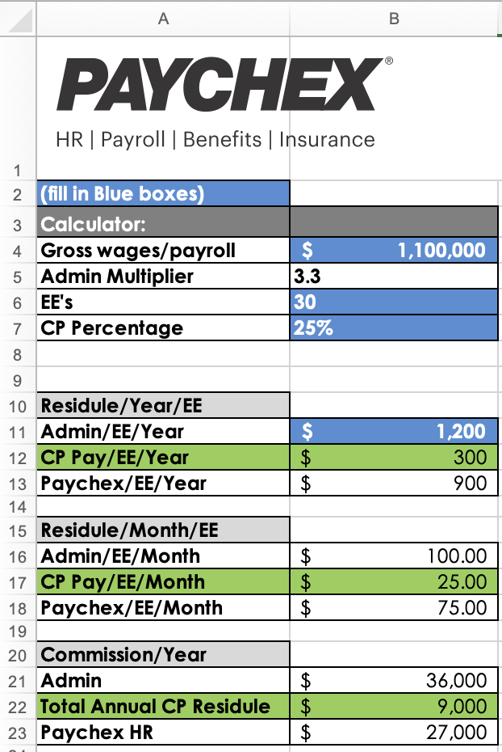
Channel Calculator
Provide data and review progress
Aid with payout calculations
Establish metrics and goals
Create accountability
Measure performance
Ongoing discussions
Determine best fit for both parties
Notes:
Let me show you how we can strategize towards your goals with our channel partner calculator.
We can also look at commissions for particular deals.
Link into calculator if possible

Slide 18
Getting Started
Notes:
Next, I would like to discuss how we get started.

Slide 19
Define The Goals And Set Expectations
Schedule weekly, biweekly, or monthly meetings
Define business goals
Provide ongoing education, client testimonials, product demos, discuss incentive programs, training, product and service updates
Get feedback, suggestions, and strategic discussions
Notes:
The first thing we need to do is set our meeting calendar.
Let’s work through the calculator to set our business goals.
The best way to learn our process is to work through a referral, I would love to have you sit in the discovery meeting, help gather underwriting documents, and participate in the proposal presentation.
We also have additional tools and resources to support your conversations with your clients.

Slide 20
Key indicators of an Ideal PEO Client
Start-ups
(A turn-key solution)
Differentiate from Competitors
(Wants to stand out from the competition)
Downsizing
(Needing scalable solutions as they rebuild)
Technology Upgrade
(Needing a more robust technology solution that integrates)
Growing Companies
Multi-Site
(Consistency in culture, process, trainings, message)
Lacking HR Infrastructure
(Burdened with compliance and regulatory demands)
Investing in Employees
(ROI in workforce)
Multi-State/Jurisdiction (Payroll, tax laws and policies. EE Handbook customized by state)
Acquisition or Merger
(Internal Restructuring)
Notes:
Spend time speaking to this slide.
Here are some key indicators of an ideal PEO client. Understanding these indicators will help you identify your clients needs and be proactive in introducing them to the Paychex HR Solution before a competitor calls on your client.
Being proactive in today’s competitive environment sets you apart and the Paychex HR solution allows you to enhance your offerings to your clients.

Slide 21
Sample Talk Tracks
Current Client XYZ
Potential Client XYZ
I’m reaching out with some exciting news. In the past I’ve not been able to assist with portions of your HR needs. I’m now working with a national PEO. I can now assist with things like payroll, training, HR outsourcing, recruiting, performance management, insurance, HCM, and more. Will you meet with me next Tuesday to see if I might be able to add additional value to you?
I’m reaching out with some exciting news. I’m now working with Paychex to offer you additional PEO solutions and services. I can now assist with things like payroll, training, HR outsourcing, recruiting, performance management, insurance, HCM, and more. Will you meet with me next Tuesday to see if I might be an additional resource for you?
Notes:
Here are sample talk tracks to help you introduce us to your clients.

Slide 22
RFP Submission Process
Reach out to your dedicated Paychex HR Strategic Business Consultant (SBC)
Submit documents to SBC over secure "Getting Started" portal
Analysis sheet
Current plan designs
Employee information and data
If applicable, workers’ compensation reports/loss runs, 401k, and other ancillary information
Paychex Channel Manager provides strategy and relationship management
Notes:
(Sales to discuss) This is a quick review of our RFP submission process

Slide 23
Tools and Resources
Notes:
We have additional tools and resources to help you communicate our new partnership to your clients.

Slide 24
Co-Branding/ Marketing
Flyers
Brochures
Webinars
Tradeshows
Notes:
We offer marketing flyers that can be co branded by adding your logo. We can also provide content and support for any newsletters, webinars and events you may have within your organization. Here is an example of our Hotel flyer we have many vertical flyers, such as technology, education and hospitatlity.

Slide 25
Paychex HR Channel Resources
Tools and resources to support our partnership:
Channel Partner Portal
Welcome Letter
Intro Letter
Sales Calculator
Channel Partner Agreement - Example
Program Support: peo_channelpartners@paychex.com
The sales calculation is for illustrative purposes and that the information is dependent on the agreement between Paychex and the Channel Partner.
Notes:
With your welcome letter you received a link to the channel partner portal where you will find the calculator, all of our vertical flyers, as well as this channel partner playbook.

Slide 26
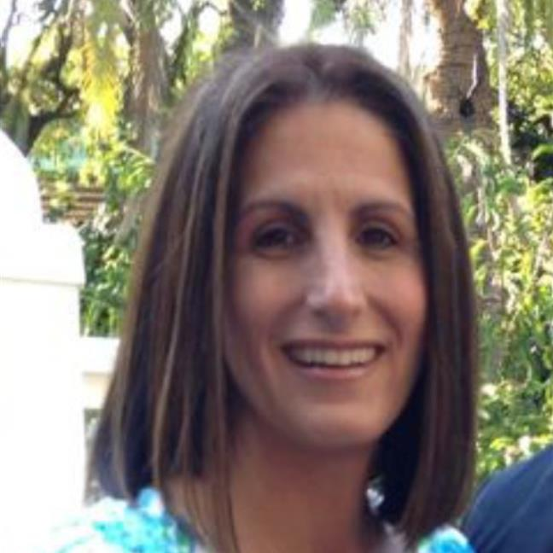
National Team
A National Channel Team with a dedicated Channel Manager in your area to provide support
Alina Gabbard
Sr. Manager, Business Development - Channels
Jamie Kelley
Business Development
Program Manager-Channels
Marijke Karreman
Sales Enablement Analyst II
Stacy Porcaro-Jeffcoat
Business Development Manager sporcarojeffcoat@paychex.com
Cathy Oneill
Business Development
Administrator
Ron Finamore
Channel Manager-
Mid-Atlantic
rffinamore@paychex.com
Shawn Petersen
Channel Manager-
Central & Midwest
sdpetersen@paychex.com
Mariah Bertram
Channel Manager- Southwest & Western
mbertram@paychex.com
Megan Cassidy
Business Development
Administrator
Venessa Fierro
Business Development
Administrator
Luciano Garcia
Channel Manager- Southeast
lgarcia2@paychex.com
Teresa Cruse
Channel Manager- South
tcruse@paychex.com
Michael Pirrello
Channel Manager- Northeast
mpirrello@paychex.com
Team email box: peo_channelpartners@paychex.com
Notes:
As you can see Paychex is making you a priority by investing in a dedicated team that supports our partnerships. If you have any general questions regarding the program, please email peo_channelpartners@paychex.com

Slide 27
Copyright Paychex Inc. 2022 | 1379805 | Rev. 10/27/22

Slide 28
Complete HCM PEO Portfolio
Key
* Prism Add-On
** Paychex Flex Add-On
*** Prism Only
HR
Payroll
Benefits
Risk Management
Administration
Recruiting
Job Descriptions
Compensation Product
Applicant Tracking */**
Recruiting Support */***
Hiring & Onboarding
Verification Services
E-Verify **
Electronic Onboarding
Employee Handbook
New Hire Reporting
Background Checks *
Drug Screening *
Behavioral & Skills Assessment */**
Managing Employees
Training
Performance Management *
Employee Engagement/Surveys/Plans
Retention Strategies
HR Consultation for Disciplinary, Termination, Harassment
Recordkeeping
Direct Deposit & Debit Card Payment Options
Job Costing
Garnishments & Other Deductions
Tax Management
General Ledger
Reports
Work Opportunity Tax Credit (WOTC) Program
FICA Tax Tip Credit Reporting
Expense Management */**
Time & Attendance */**
Health & Ancillary Benefits
Health Insurance */**
Minimum Essential Coverage */***
GAP */***
Telemedicine */**
Dental */**
Vision */**
Life / AD&D */**
Short- & Long-Term Disability */**
Other Benefits
Health Advocacy Services
Health Savings Account
Flexible Spending Account
Transit Section 132 Plan **
College Savings Program ***
Employee Assistance Plan
401(k) *
Employee Discount Program
Financial Wellness Program
Legal Plan */**
Workers’ Compensation
Insurance */**
Safety & Loss Services
Federal & State Employment Law Compliance Assistance
Protection Plus */**
Employment Forms & Posters
Workers’ Compensation
Insurance */**
Safety & Loss Services
Federal & State Employment Law Compliance Assistance
Protection Plus */**
Employment Forms & Posters
Unemployment Claims
HR Professional: Performs an assessment of the business to determine the needs, creates an action plan to address them and coordinates the relevant aspects of the service.
Prism and Paychex Flex: Software platforms with single-sign-on functionality and mobile responsive designs that help handle administrative responsibilities.
Notes:
Here is a detailed breakout of how we might guide a client to either Flex or Prism as a HCM platform.

Slide 29
Dedicated Support and HR Guidance Tailored to Your Client’s Business Needs
A Paychex Service Team will support your clients at every stage, from strategy to execution.
Safety Consultant
Payroll Specialist
HR Professional
Client Advocate
Benefits Specialist
Notes:
Rep Notes:
Every business benefits from expertise and proactive support
Your client will get assigned a dedicated HR professional – that person will proactively help assess your HR needs, offer advice and solutions, and help with how to manage employees strategically and day to day
You mentioned your clients [have no HR manager / do it all yourself / have an office manager who handles it / have a small HR staff] – your HR Professional will be able to fill the gaps and support you and your team
Paychex also has a huge team of specialists supporting the HR professional and you – compliance professionals monitoring federal and state laws and regulations, safety experts to support you with OSHA requirements and benefits and payroll specialists to keep your team supported

Slide 30
Areas of Opportunity
Lack of HR Infrastructure
Payroll Issues
Safety and Workers’ Compensation Risk Issues
Little to no HCM in place
Excessive turnover
Concerns with litigation and lawsuits
Workplace conflict resolution
Compliance with employment law regulations
Inadequate disciplinary actions or procedures
History of sexual harassment allegations
Lack of background screenings
Time consuming processing
Child support garnishments
Dissatisfaction with current payroll vendor
Payroll tax deposit liability
History with payroll tax penalties and liabilities
No post-accident drug testing
Inadequate safety programs and training
Inadequate OSHA compliance
History of fraudulent workers comp claims
No workers’ compensation plan
No claims management process in place
Workers’ compensation down payment
Lacking a return-to-work program

Slide 31
Areas of Opportunity
Benefit Issues/Costs
Compliance Issues
Limited plan options
No section 125
High annual renewal costs
No retirement options
Ineffective claims management
HIPAA
Immigration
Unemployment claims
COBRA
FLSA
No EPLI coverage
Diversity and inclusion
Local laws and statutes

Slide 32
Next-Level Partnership
HR & Compliance
HR Advice in accordance with regulations
Dedicated certified HR professional
supported by the compliance team
Selecting and hiring employees
Day-to-day employee management
Employee compensation and assessments
OSHA safety
Employee Benefits
Productivity and retention
Benefits administrator
Health
Dental
Vision
Retirement
Employee elective benefits
Wellness support
Risk Management Products Business and employee protection
Employer Practices Liability Insurance (EPLI)
Cyber liability
Workers’ compensation
Life insurance
Disability insurance
Employee supplemental insurance
Technology
Digital agility
Paychex Flex & Prism platforms
Single sign-on
HR administration
Reporting
Employee training
Notes:
Notes:
Professional Employer Organizations (PEOs) is an innovative HR outsourcing model that consolidates and removes tactical non-revenue generating HR functions to a single source, like Paychex. Within this model, we’re also able to provide your clients with robust and competitive benefits at an affordable cost. This approach provides the freedom for our business owners to focus in on their core competencies, so they can execute and exceed their financial goals.
Paychex PEO provides your clients with the ability to compete at a fortune 500 level as a small business owner. We make the complex challenges of competing in the market place and providing benefits easy because of our ability to negotiate on their behalf.

